Slide 1


Developing React Templates Using SharePoint Framework Library Components
Alex Terentiev

Slide 2












Thanks to our Sponsors

Slide 3






About Myself
Custom solutions architect and lead developer in Sharepointalist Inc.
10+ years of experience with SharePoint
Extensive experience in front-end development
Regular contributor to SharePoint Patterns and Practices
SharePoint Dev Kitchen Awards: March 2017, July 2018
@alexaterentiev
http://blog.aterentiev.com/
https://github.com/AJIXuMuK
https://www.linkedin.com/in/alekseiterentiev/
Notes:
Few words about myself.
I’m Office Dev MVP.
I’m custom solutions architect and lead developer in Sharepointalist.
I have 10 years of experience with SharePoint and also huge experience in front end development and tools.
Also I’m a regular contributor to SharePoint Patterns and Practices Initiative.
I was twice awarded during SharePoint Dev Kitchen events
But more important is social media.
So, follow me on Twitter, visit the blog, Github and feel free to connect with in on LinkedIn.

Slide 4
About Yourselves
Developers?
Familiar with SharePoint Framework?
Familiar with React?
Familiar with Library Components?
YES TO ALL – What are you doing here? ☺

Slide 5
Agenda
SharePoint Framework overview
SPFx Library Components
React basics
React templates

Slide 6
SharePoint Framework Overview

Slide 7
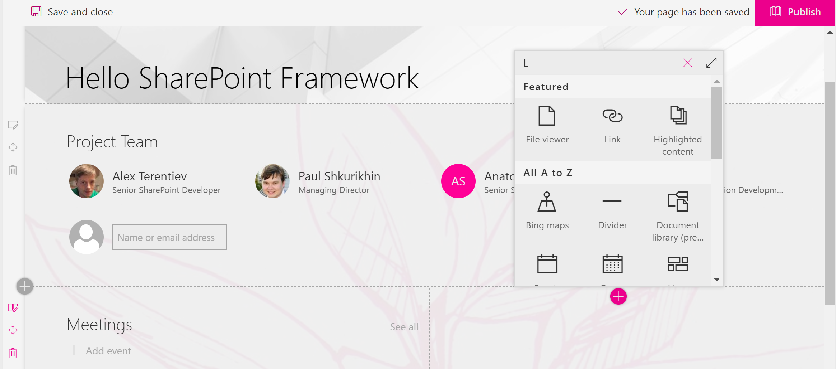
What is SharePoint Framework
The SharePoint Framework (SPFx) is a modern way to develop SharePoint customizations.
Client-side
Modern
Mobile first
Framework agnostic
Based on commonly used web development tools
Notes:
1st party SharePoint components are developed using SPFx as well. It makes SPFx a unique dev platform as SharePoint Dev team and 3d party developers are in the same boat.

Slide 8






Development Toolchain
Hosting and serving environment
Package Manager
Modules transformer, bundler, packager
Typed superset of JavaScript
Templates engine with generators ecosystem
Extendable task runner

Slide 9
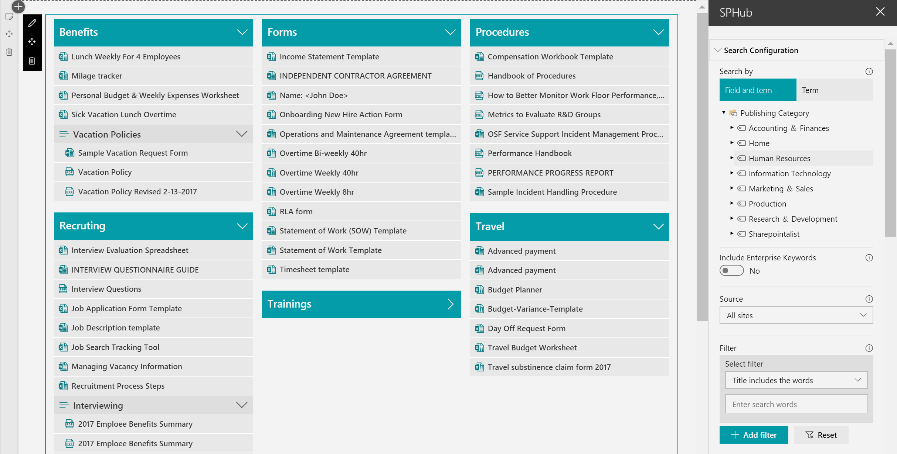
What’s Available?
Client-Side Web Parts

Slide 10
What’s Available?
Extensions

Slide 11
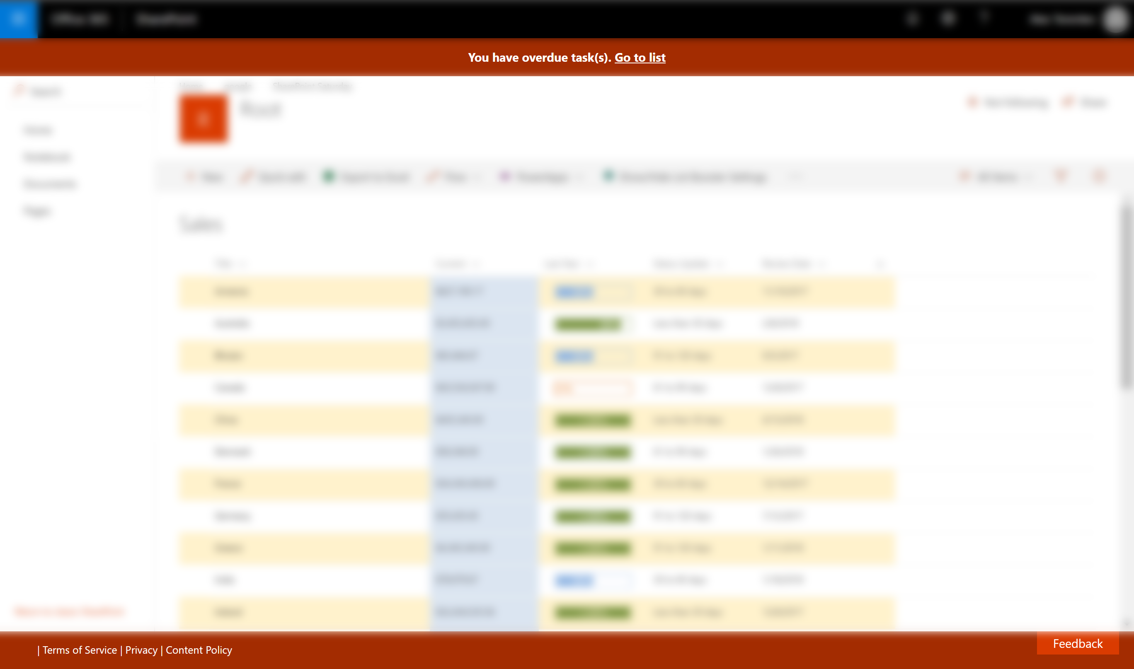
What’s Available?
Application Customizer can be embedded to Page Header or Page Footer… or be invisible.
Extensions

Slide 12
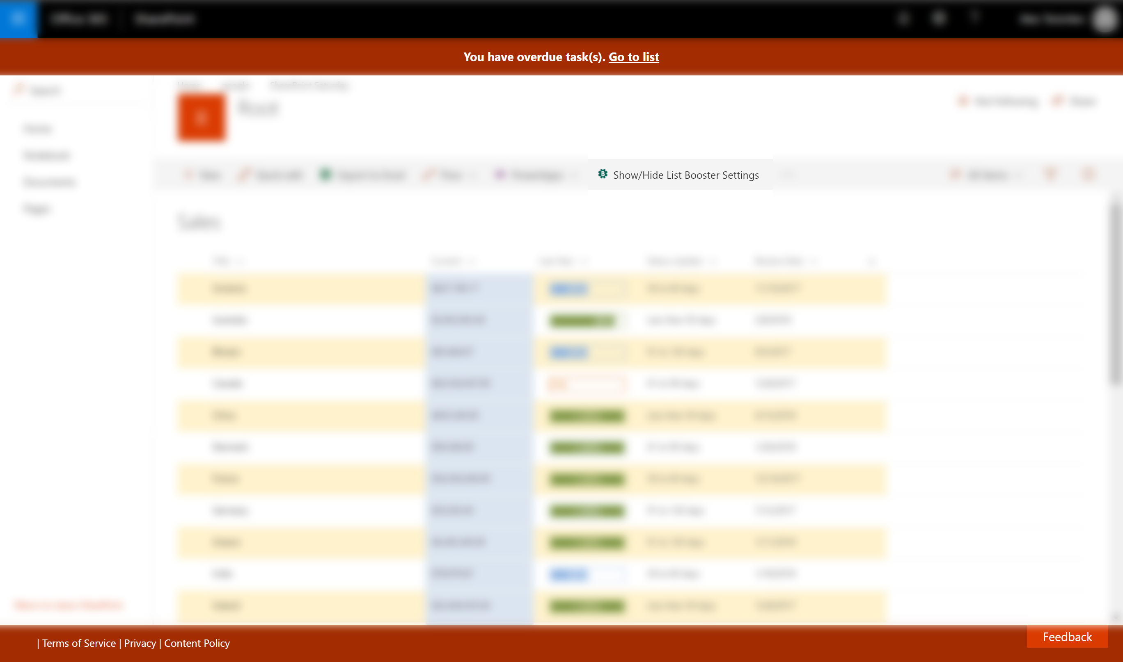
What’s Available?
Application Customizer can be embedded to Page Header or Page Footer… or be invisible.
Extensions
Command Set Customizer is used to add new custom actions to the list Command Bar and List Item Context Menu

Slide 13

What’s Available?
Application Customizer can be embedded to Page Header or Page Footer… or be invisible.
Field Customizer is used to apply custom experience (rendering) to specific fields
Extensions
Command Set Customizer is used to add new custom actions to the list Command Bar and List Item Context Menu

Slide 14

What’s Available?
Library Components

Slide 15
Minimal Path to Awesome
Install NodeJS and NPM on your machine. Note: SPFx supports NodeJS 8.x and 10.x
Install IDE (Visual Studio Code, Webstorm, etc.)
Install Yeoman and Gulp
npm i –g yo gulp
Install Yeoman SharePoint Generator
npm i –g @microsoft/generator-sharepoint
Scaffold new SPFx project in selected folder
yo @microsoft/sharepoint
Trust the self-signed developer certificate – only once
gulp trust-dev-cert
Run the project
gulp serve
Notes:
IDE should support front-end development
SharePoint generator can also be installed in the project’s folder. In that case it is possible to have multiple different versions of the generator
QUESTION: Who knows what –g parameter means.

Slide 16
SPFx Library Components

Slide 17
Library Component Project Type
Allows to have independently versioned and deployed SPFx code
Deployed through tenant app catalog and hosted automatically for other SPFx components (if referenced)
Alternative option to create shared code referenced across tenant
Only one version of a library component is hosted at a time
SPFx solution with library component can’t contain any other component types (extensions or web parts)
Library components are not supported when solution is deployed to site collection app catalog
Notes:
Описание лайбрари компонент из официальной документации

Slide 18
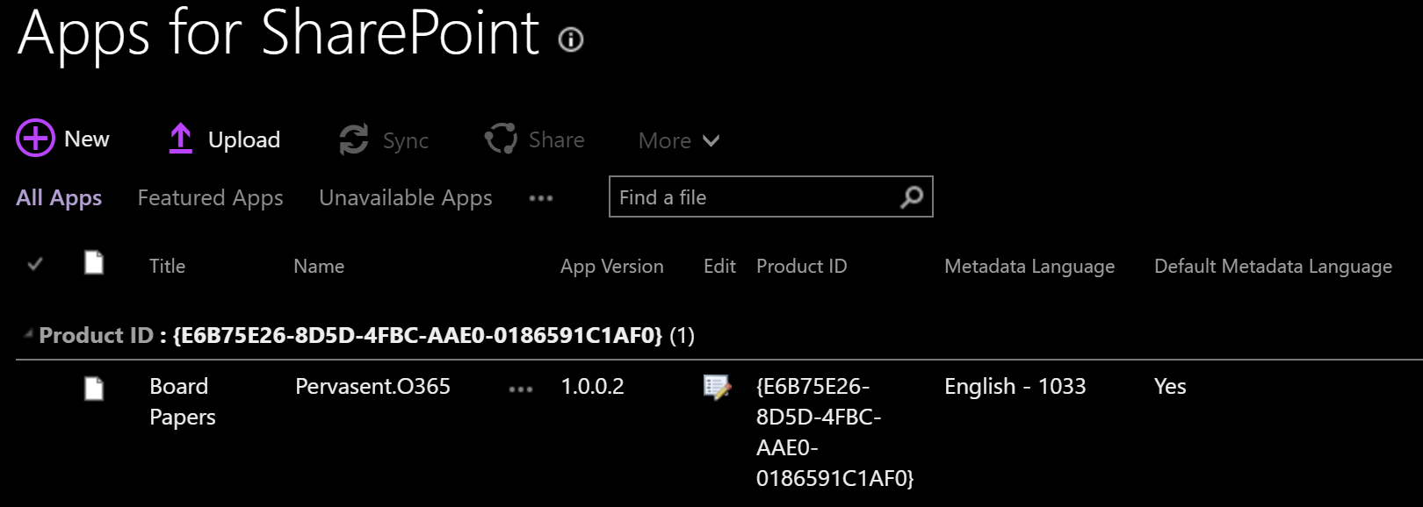
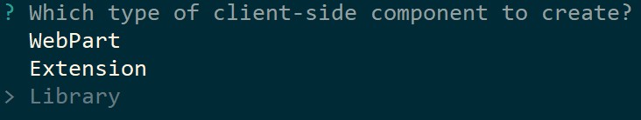
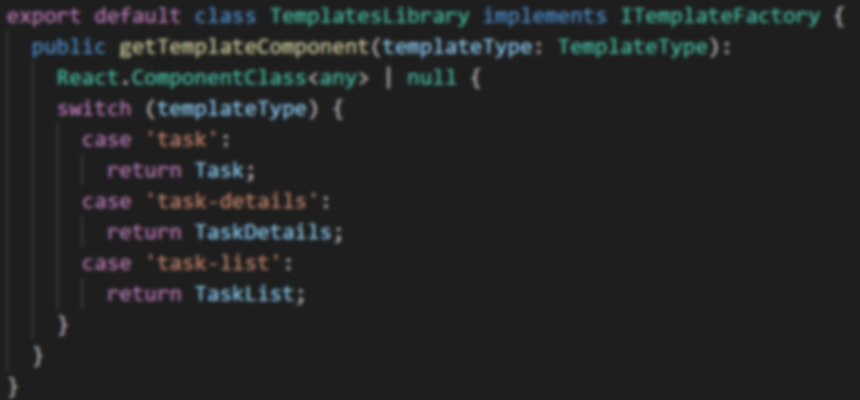
Create, Deploy, Use Library Component
yo @microsoft/sharepoint
gulp bundle --ship
gulp package-solution --ship
"dependencies": {
"templates-library": "1.0.0"
}
Or
const module: any = await SPComponentLoader.loadComponentById(componentId);
Notes:
Алгоритм, как создается лайбрари компонент, деплоится в апп каталог и потом либо через npm link, либо через SPComponentLoader подгружается другими аппами.

Slide 19
React Basics

Slide 20
Think in React
Build encapsulated components
React re-renders, not mutates components
Effectively updates and renders only needed components
Based on fast virtual DOM
Use state for component’s internal data and behavior
Use props to pass data and events in components hierarchy
props and state example: dropdown component. Items and item selection handler are passed as props. Dropdown expanded/collapsed – internal state.

Slide 21
Implementing a Component
Reference react and react-dom
.jsx or .tsx file – component’s logic and markup
Markup is returned from component’s render method
Change of props and/or state leads to re-render
Lowercase tags – default HTML, mixed case tags – custom components
Events are camelCased, not lowercased (onClick instead of onclick)
You should pass a function, not a string as an event handler

Slide 22
Demo: Simple React Component

Slide 23
Demo: Simple React Component
import React from 'react'; export class MyComponent extends React.Component {
constructor(props) {
super(props);
this.state = { numberOfClicks: 0 };
} render() {
const numberOfClicks = this.state.numberOfClicks;
return (<div>
<button onClick={() => {
alert(`${this.props.text}, number of clicks: ${numberOfClicks}`);
this.setState({ numberOfClicks: numberOfClicks + 1 });
}}>Click me!</button>
</div>
);
}
}
export class App extends React.Component {
render() {
return (<div>
<header>
My First React App
</header>
<MyComponent text={'Button click text'} />
</div>
);
}
}
Notes:
Add rectangles and animations

Slide 24
React Templates

Slide 25
The Problem
Developers often need to create different UI/behavior for different customers or surfaces
Plain HTML and most of templates libraries (like Handlebars.js) allow “static” templates
How to handle template’s events with external handlers?
How to make templates in “React” way?
How to dynamically load those templates to SPFx components?
How to have TypeScript type checking in templates?

Slide 26

The Solution
+

Slide 27
Key Implementation Details
Any mixed case tag is a custom component!
const TaskList = components['task-list'];
return (
<TaskList strings={strings} tasks={tasks} />
);
React.ComponentClass allows to add type checking of passed parameters
const TaskList = components['task-list'] as React.ComponentClass<ITaskListProps>;
Library component is just an SPFx project with all the configurations available
SPComponentLoader.loadComponentById allows to dynamically load SPFx components, including Library Components
We just need to know the “contract” or API exposed by the Library Component

Slide 28
Demo: React Template Using SPFx Library Component

Slide 29
Resources
http://aka.ms/spfx – SPFx overview
http://aka.ms/spfx-tutorials – SPFx Dev tutorials
https://docs.microsoft.com/en-us/sharepoint/dev/spfx/library-component-tutorial – Library Component tutorial
https://reactjs.org/docs/getting-started.html – React documentation
http://aka.ms/sppnp – community
http://blog.aterentiev.com/2019/06/react-templates-using-spfx-library.html – Blog post about React templates using SPFx Library Components
https://github.com/AJIXuMuK/demos/tree/master/react-templates – demo from this session
https://github.com/AJIXuMuK/SPFx/tree/master/react-templates – more complex sample of React Templates
https://n8d.at/blog/tips-and-tricks-working-with-spfx-library-components - great blog post by Stefan Bauer on Library Components Tips and Tricks
http://warner.digital – David Warner II blog with great posts around Library Components

Slide 30
Questions?

Slide 31

Session Survey
http://bit.ly/react-templates-survey

Slide 32
Thank You!

